Slide 1
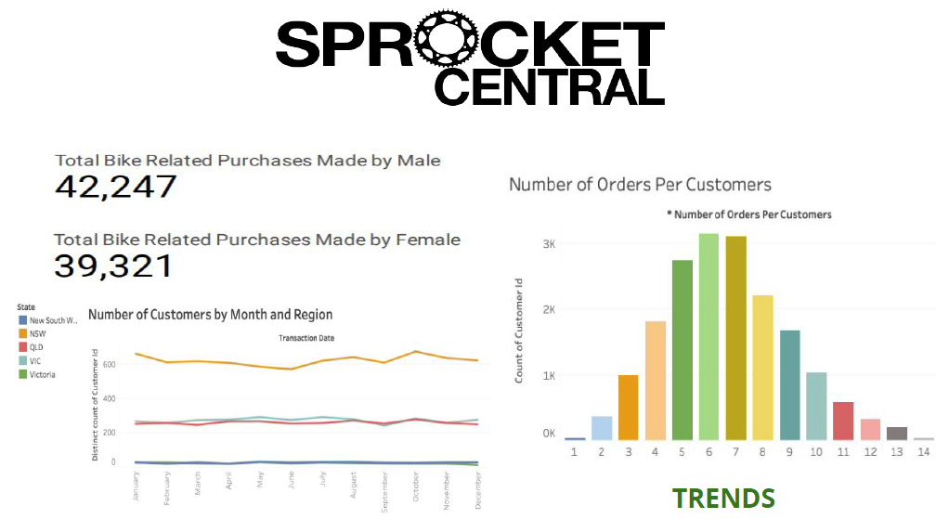

Slide 2
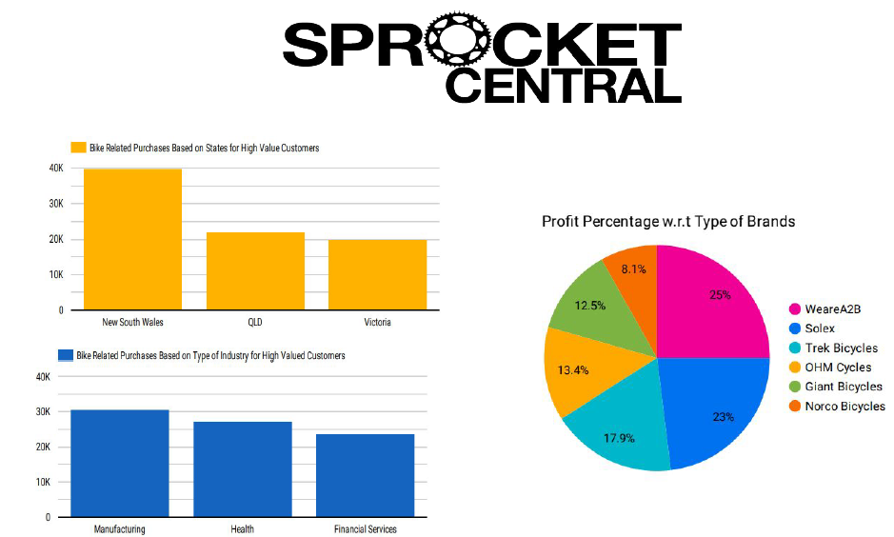

Slide 3


Slide 4
THANK YOU
Submitted By
Aditya Dey
aditya.dey0409@gmail.com

